Slide 1
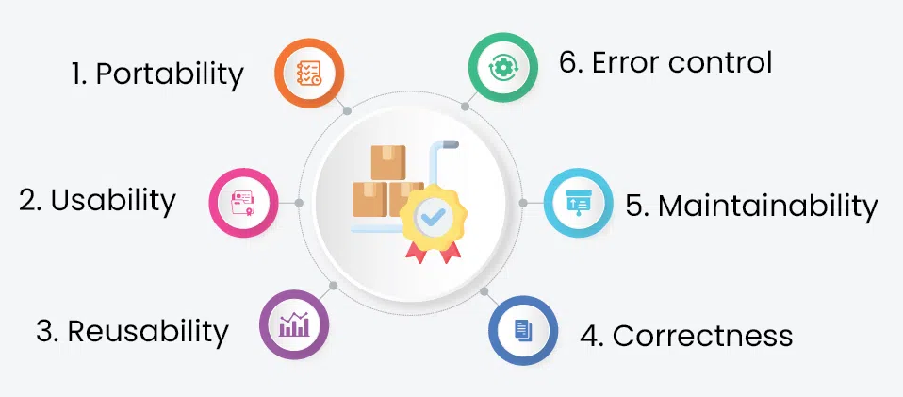
Chapter 8 : Software Quality Assurance
Assit.prof. Juthawut Chantharamalee
Curriculum of Computer Science
Faculty of Science and Technology, Suan Dusit University

Slide 2
Four Stages of Software Development
1. Software Requirements Specification
2. Software Design
3. Implementation (Coding & Module Testing)
4. Integration & Testing
Each stage will require some sort of Software Quality Assurance (SQA).

Slide 3
What is SQA?
In respective stages of software development
The degree to which a system, component, or process meets specified requirements.
The degree to which a system, component or process meets customer or user needs or expectations.

Slide 4
Software Quality Assurance
SQA encompasses the entire software development process
1. software requirements
2. software design
3. coding
4. source code control
5. code reviews
6. change management
7. configuration management
8. release management

Slide 5
IEEE Std 730-2002 SQAP

Slide 6
IEEE Std 730-2002

Slide 7
Targeted Audience

Slide 8
Content of SQAP - Software Quality Assurance Plan¹⁾
1. Purpose
2. Reference documents
3. Management
4. Documentation
5. Standards, practices, convention, and metrics
6. Software Reviews
7. Tests
8. Problem reporting and corrective actions
9. Tools, techniques, and methodologies
10. Media control
11. Supplier control
12. Records collection, maintenance, and retention
13. Training
14. Risk management
15. Glossary
16. SQAP change procedure and history
¹⁾ Underlined sections will be included in our project’s SQAP

Slide 9
Reviews in Project Life Cycle

Slide 10
Testing
1. Unit Testing
– individual components are tested for correctness.
2. Integration Testing
- units that have already been tested are combined into a component and the interface between them is tested. Identifies problems that occur when units are combined.

